Slide 1
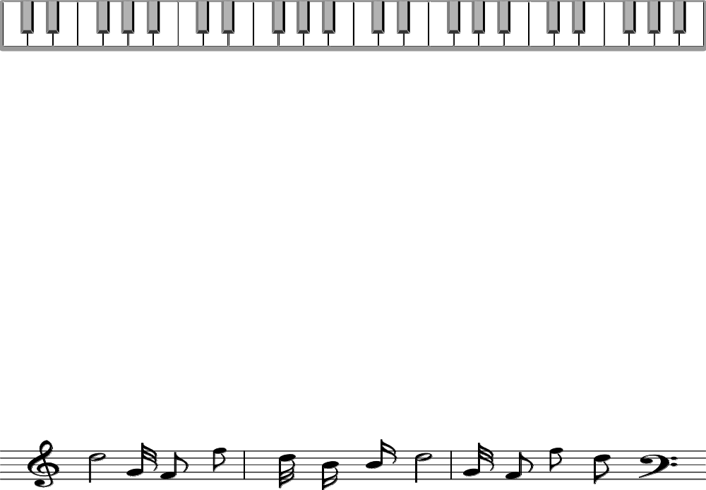
Music Note Reading
Basic Lessons

Slide 2
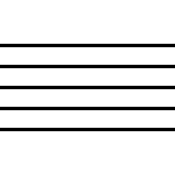
The Staff

Slide 3

The G-clef or Treble-clef

Slide 4

The F-clef or
Bass-clef

Slide 5
Ledger Line

Slide 6
Ledger Line

Slide 7
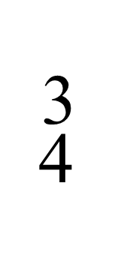
Time Signature

Slide 8
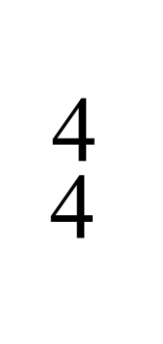
Time Signature

Slide 9
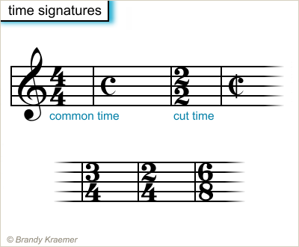

Slide 10
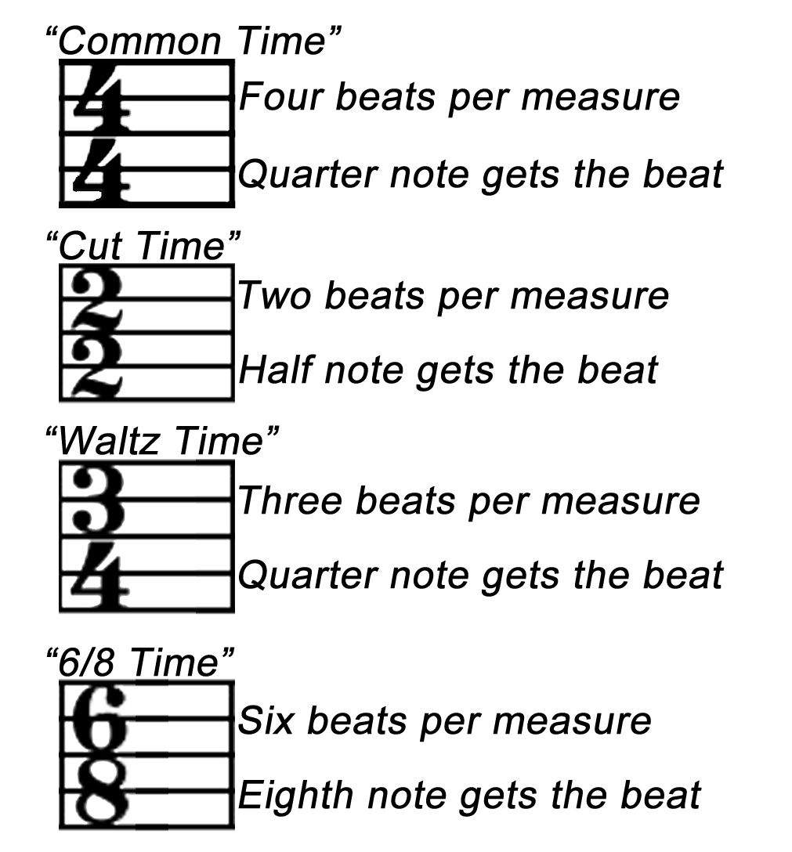

Slide 12
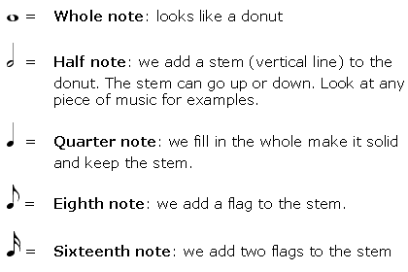
Note Values

Slide 13
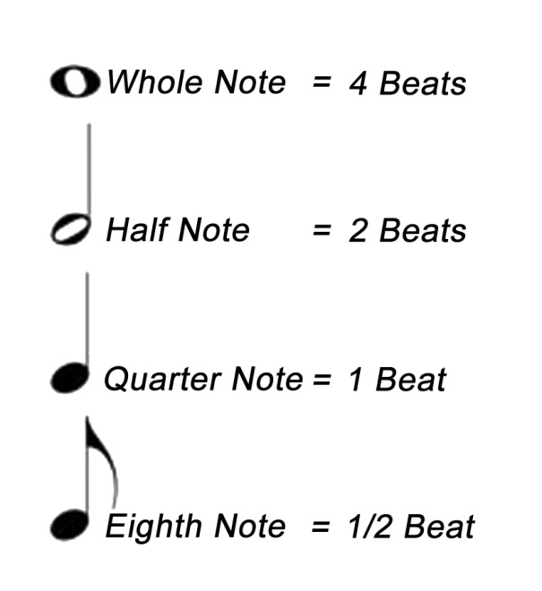
Note Values

Slide 14
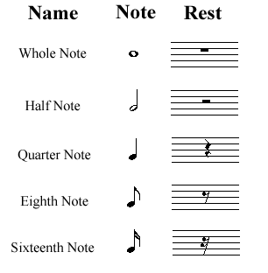
Notes and Rests

Slide 15
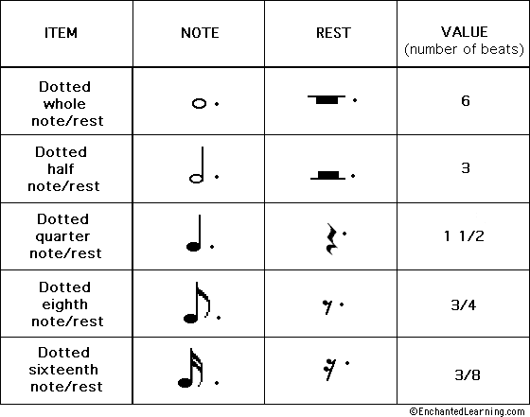
Dotted Notes and Rests

Slide 16
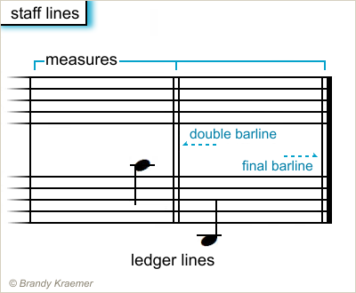
Staff Lines

Slide 17
References:
Davis, R. (n.d.). Music Theory Basics (Part 2). Kennedy Violins. Retrieved July 21, 2013, from blog.kennedyviolins.com/2012/11/music-theory-basics-part-2/
Kraemer, B. (n.d.). Staff and Bar Lines - Building a Musical Staff. Piano - How to Play Piano - About Piano Music. Retrieved July 21, 2013, from http://piano.about.com/od/musicaltermssymbols/ss/introSheetMusic.htm
Kraemer, B. (n.d.). Time Signatures - Musical Symbols - Understanding Time Signatures. Piano - How to Play Piano - About Piano Music. Retrieved July 21, 2013, from http://piano.about.com/od/musicaltermssymbols/ss/introSheetMusic_3.htm
Music Note Symbols. (n.d.). Music Learning Workshop - Learn Music and Master Music. Retrieved July 21, 2013, from http://www.musiclearningworkshop.com/music-note-symbols.html
Music Theory - Note Reading . (n.d.).ThinkQuest : Library. Retrieved July 21, 2013, from http://library.thinkquest.org/15413/theory/note-reading.htm
UG Community @ Ultimate-Guitar.Com - Reading sheet music - the very basics. (n.d.). ULTIMATE GUITAR TABS. 800,000 songs catalog with free Chords, Guitar Tabs, Bass Tabs, Ukulele Chords and Guitar Pro Tabs!. Retrieved July 21, 2013, from http://www.ultimate-guitar.com/forum/showthread.php?t=229342

